Slide 1
Explore datasets: FB-Forum, Enron-Email
Record the performance of models with memory in Wikipedia
Run the experiment of models (sample & t-batch respectively) with memory and without memory respectively in Reddit and Enron-Email

Slide 2
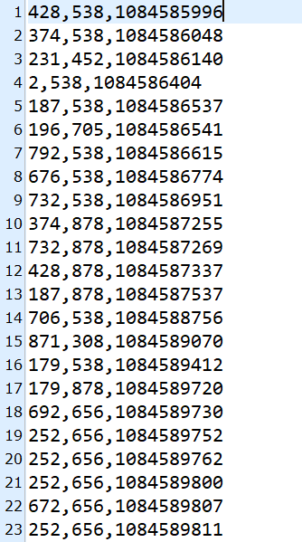
FB-Forum
fb-forum | Dynamic Networks | Network Data Repository (networkrepository.com)
https://networkrepository.com/fb-forum.php
This dataset comes from a Facebook-like online community of students at the University of California. This is a bipartite graph where the nodes represent students and groups while the edges represent students’ broadcast messages on the groups.
Dataset | Users | Items | Interactions
FB-Forum | 899 | 522 | 33720

Slide 3
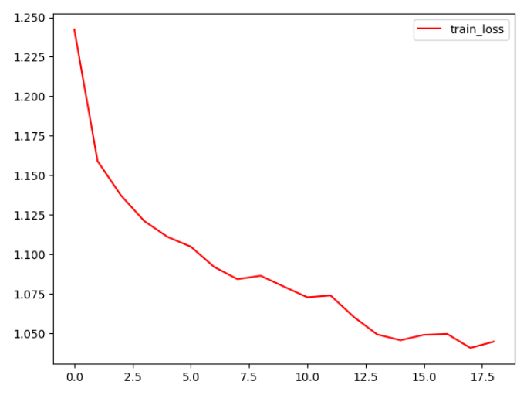
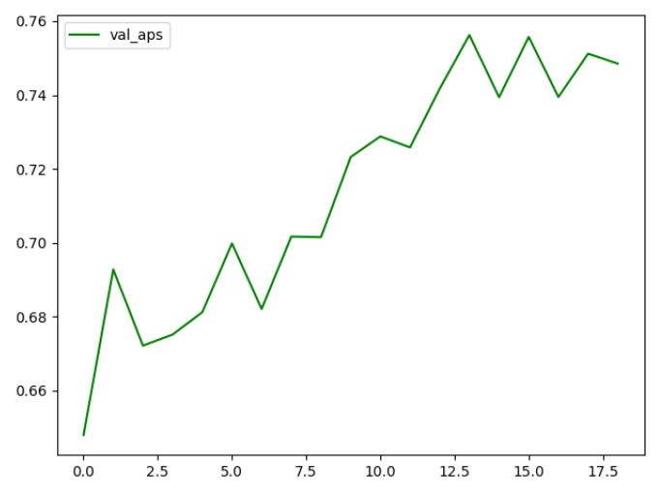
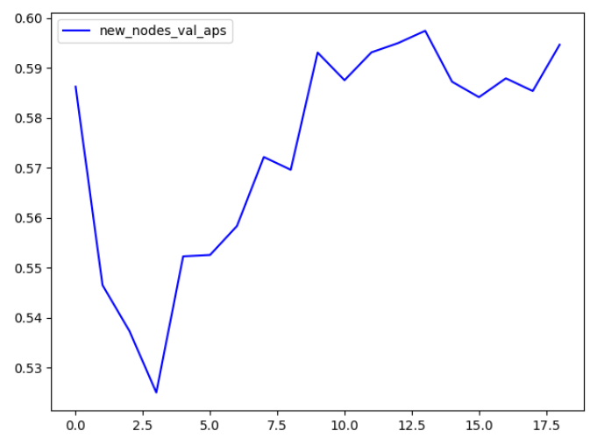
FB-Forum
fb-forum | Dynamic Networks | Network Data Repository (networkrepository.com)
https://networkrepository.com/fb-forum.php
Dataset | Test AP (Transductive) | Test AP (Inductive)
FB-Forum | 0.7915 | 0.6563

Slide 4
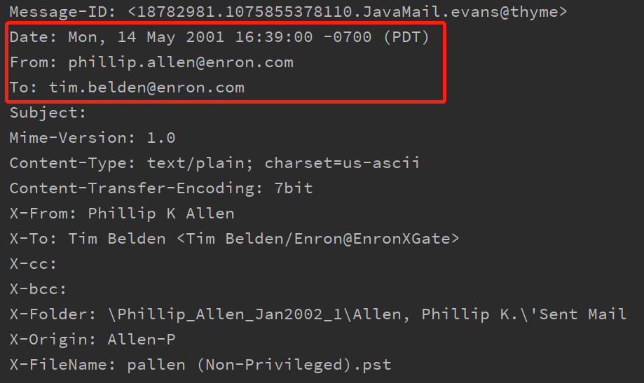
Enron-Email
The Enron Email Dataset | Kaggle
https://www.kaggle.com/datasets/wcukierski/enron-email-dataset
Enron email dataset (Klimt and Yang (2004)) is the network of email exchanges among the employees of Enron. This data was originally released by the Federal Energy Regulatory Commission as part of their investigation. It has been widely used in the community (Nguyen et al. (2018b); De Winter et al. (2018); Chen et al. (2018a); Sankar et al. (2018))
Dataset | Users | Items | Interactions
Enron-Email | 18993 | 25274 | 517401

Slide 5
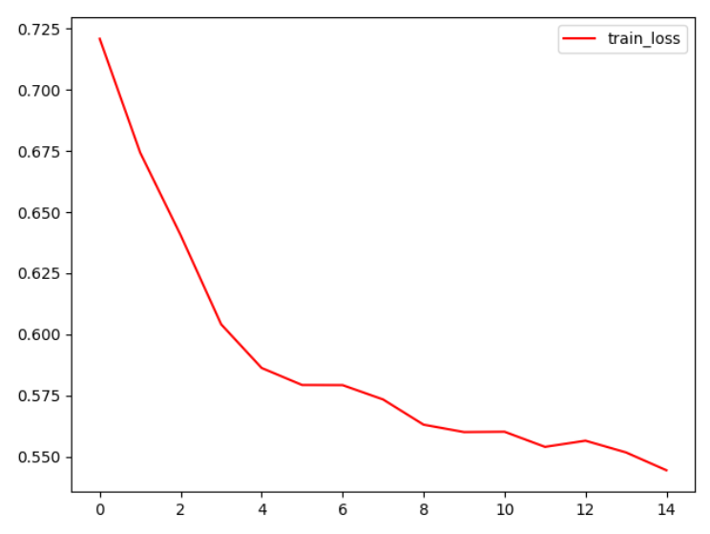
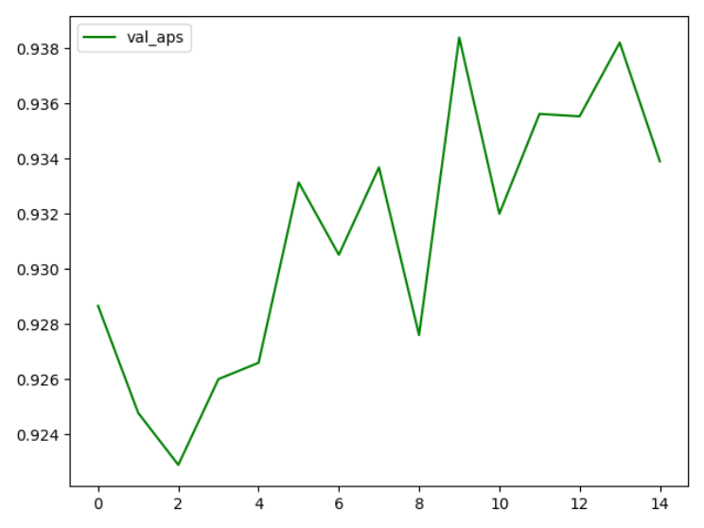
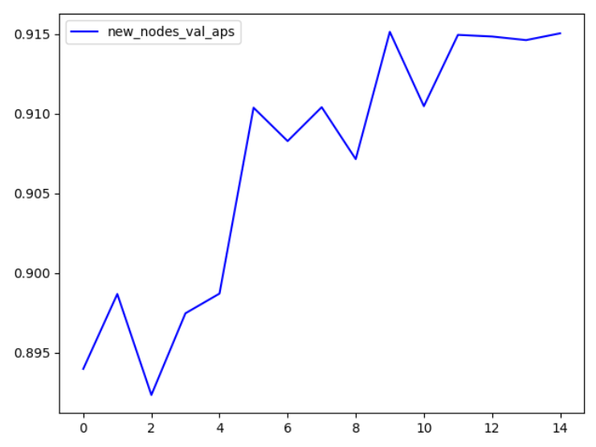
Enron-Email
The Enron Email Dataset | Kaggle
https://www.kaggle.com/datasets/wcukierski/enron-email-dataset
Dataset | Test AP (Transductive) | Test AP (Inductive)
Enron-Email | 0.9690 | 0.9176

Slide 6
Sample | Test AP (Transductive) |  | Test AP (Inductive)
 | w/o memory | w/ memory | w/o memory | w/ memory
4(0) | 0.9419 | 0.9820 | 0.9417 | 0.9752
4(1) | 0.9415 | 0.9823 | 0.9411 | 0.9769
4(average) | 0.9167 | 0.9783 | 0.9163 | 0.9715
4(combine) | 0.9477 | 0.9843 | 0.9474 | 0.9791
8(0) | 0.9395 | 0.9728 | 0.9384 | 0.9666
8(1) | 0.9371 | 0.9759 | 0.9359 | 0.9675
8(average) | 0.9277 | 0.9739 | 0.9260 | 0.9686
8(combine) | 0.9432 | 0.9763 | 0.9429 | 0.9715
16(0) | 0.9244 | 0.9615 | 0.9235 | 0.9557
16(1) | 0.9183 | 0.9601 | 0.9181 | 0.9556
16(average) | 0.9214 | 0.9656 | 0.9194 | 0.9618
16(combine) | 0.9161 | 0.9570 | 0.9152 | 0.9541
32(0) | 0.9024 | 0.9384 | 0.8997 | 0.9371
32(1) | 0.9024 | 0.9418 | 0.8946 | 0.9402
32(average) | 0.9047 | 0.9441 | 0.9011 | 0.9418
32(combine) | 0.9181 | 0.9235 | 0.9162 | 0.9234
Wikipedia

Slide 7
Wikipedia
Sample | Test AP (Transductive) |  | Test AP (Inductive) |  | Time
 | w/o memory | w/ memory | w/o memory | w/ memory | w/o memory | w/ memory
1 | 0.9286 | 0.9277 | 0.9272 | 0.9234 | 0.2523 | 1.4092
2 | 0.9200 | 0.9224 | 0.9197 | 0.9189 | 0.4866 | 2.4025
4 | 0.9211 | 0.9614 | 0.9186 | 0.9539 | 1.0660 | 5.5749
8 | 0.9362 | 0.9733 | 0.9335 | 0.9674 | 1.9456 | 12.6140
16 | 0.9465 | 0.9806 | 0.9461 | 0.9750 | 3.6586 | 22.5398

Slide 8
Sample | Test AP (Transductive) |  | Test AP (Inductive)
 | w/o memory | w/ memory | w/o memory | w/ memory
4(0) | 0.9538 | 0.9849 | 0.9318 | 0.9727
4(1) | 0.9525 | 0.9828 | 0.9299 | 0.9707
4(average) | 0.9378 | 0.9808 | 0.9057 | 0.9669
4(combine) | 0.9546 | 0.9870 | 0.9325 | 0.9754
8(0) | 0.9418 | 0.9822 | 0.9165 | 0.9696
8(1) | 0.9437 | 0.9816 | 0.9189 | 0.9683
8(average) | 0.9292 | 0.9735 | 0.8951 | 0.9606
8(combine) | 0.9483 | 0.9830 | 0.9229 | 0.9702
16(0) | 0.9346 | 0.9735 | 0.9067 | 0.9607
16(1) | 0.9338 | 0.9758 | 0.9078 | 0.9636
16(average) | 0.9208 | 0.9705 | 0.8862 | 0.9536
16(combine) | 0.9307 | 0.9678 | 0.9067 | 0.9475
32(0) | 0.9174 | 0.9599 | 0.8862 | 0.9425
32(1) | 0.9171 | 0.9655 | 0.8858 | 0.9478
32(average) | 0.9114 | 0.9637 | 0.8753 | 0.9463
32(combine) | 0.9204 | 0.9623 | 0.8888 | 0.9416
Reddit

Slide 9
Reddit
Sample | Test AP (Transductive) |  | Test AP (Inductive) |  | Time
 | w/o memory | w/ memory | w/o memory | w/ memory | w/o memory | w/ memory
1 | 0.9282 | 0.9637 | 0.9006 | 0.9213 | 1.6961 | 5.7906
2 | 0.9345 | 0.9689 | 0.9097 | 0.9480 | 3.5920 | 15.2807
4 | 0.9407 | 0.9789 | 0.9158 | 0.9629 | 7.7395 | 36.8422
8 | 0.9484 | 0.9833 | 0.9254 | 0.9710 | 14.8441 | 76.5402
16 | 0.9551 | 0.9848 | 0.9332 | 0.9714 | 27.9549 | 159.3442

Slide 10
Sample | Test AP (Transductive) |  | Test AP (Inductive)
 | w/o memory | w/ memory | w/o memory | w/ memory
4(0) | 0.8901 | 0.9684 | 0.7819 | 0.9118
4(1) | 0.8931 | 0.9533 | 0.7834 | 0.8896
4(average) | 0.8762 | 0.9578 | 0.7611 | 0.8926
4(combine) | 0.8910 | 0.9712 | 0.7803 | 0.9198
8(0) | 0.8824 | 0.9450 | 0.7697 | 0.8726
8(1) | 0.8904 | 0.9575 | 0.7794 | 0.8932
8(average) | 0.8723 | 0.9545 | 0.7578 | 0.8839
8(combine) | 0.8813 | 0.9705 | 0.7708 | 0.9271
16(0) | 0.8808 | 0.9474 | 0.7748 | 0.8734
16(1) | 0.8829 | 0.9521 | 0.7739 | 0.8765
16(average) | 0.8576 | 0.9523 | 0.7366 | 0.8725
16(combine) | 0.8872 | 0.9393 | 0.7823 | 0.8394
32(0) | 0.8686 | 0.9428 | 0.7534 | 0.8567
32(1) | 0.8702 | 0.9446 | 0.7553 | 0.8578
32(average) | 0.8659 | 0.9467 | 0.7548 | 0.8613
32(combine) | 0.8404 | 0.9492 | 0.7533 | 0.8692
Enron
Email

Slide 11
Enron Email
Sample | Test AP (Transductive) |  | Test AP (Inductive) |  | Time
 | w/o memory | w/ memory | w/o memory | w/ memory | w/o memory | w/ memory
1 | 0.8494 | 0.9416 | 0.7612 | 0.8560 | 0.9507 | 4.4313
2 | 0.8593 | 0.9481 | 0.7821 | 0.8717 | 2.0002 | 9.9783
4 | 0.8499 | 0.9526 | 0.7600 | 0.8756 | 4.3263 | 23.9450
8 | 0.8908 | 0.9431 | 0.7971 | 0.8724 | 8.0765 | 55.4182
16 | 0.8890 | 0.9655 | 0.7884 | 0.9087 | 15.0158 | 131.7370

